Slide 1
Medical Data History
Comprehensive analysis of patient demographics, admissions trends, and health metrics across 4,530 total patients from June 2018 to June 2019.
Name: Dhanraj Beldar
Project id: PTID-CDA-JAN-26-1198

Slide 2
Key Healthcare Metrics
4,530
5,067
44
27
Total Patients
Total Admissions
Average Age
Total Doctors
Comprehensive patient database
Hospital visits recorded
Mean patient age in years
Medical staff on record

Slide 3
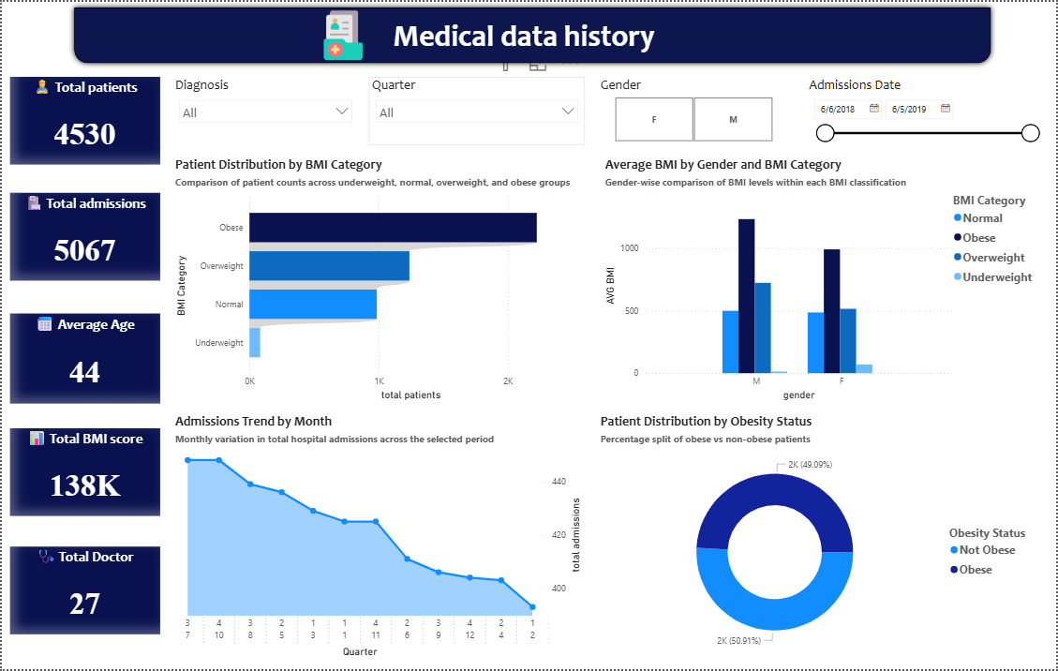

Slide 4
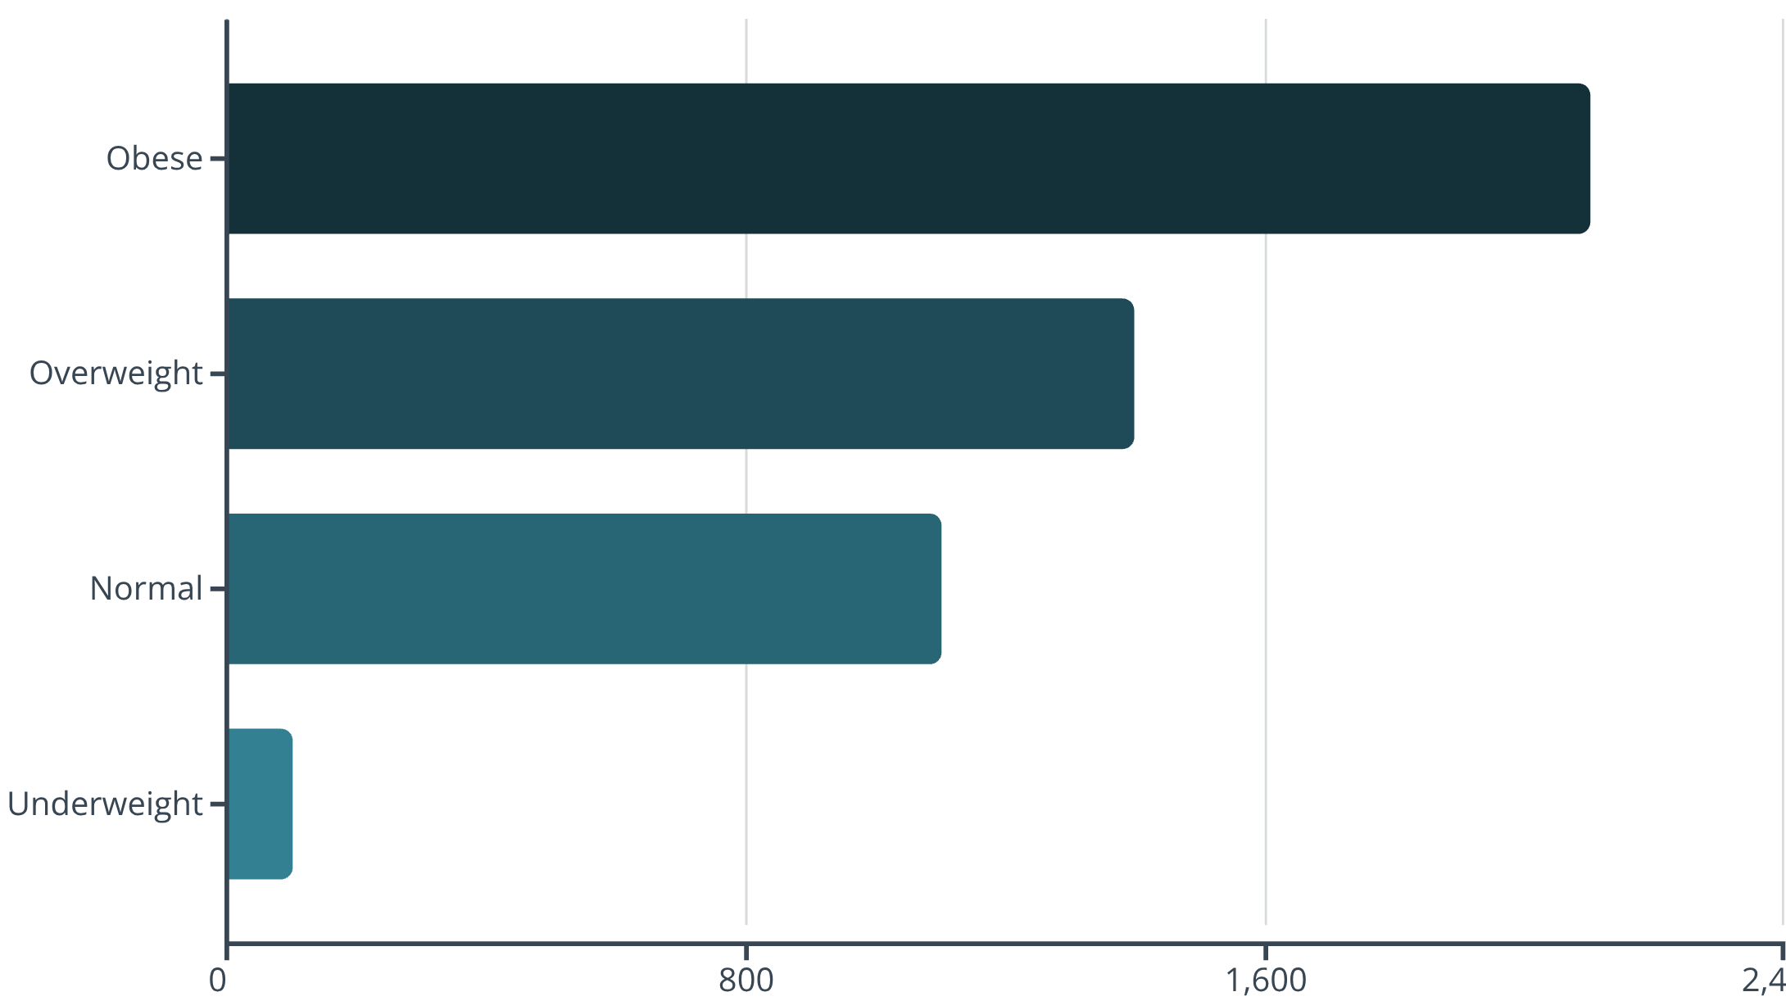
Patient Distribution by BMI Category
Distribution Insights
The obese category represents the largest patient group with approximately 2,100 patients, followed by overweight at 1,400. Normal weight patients account for 1,100, while underweight patients represent the smallest group at just 100.
This distribution highlights significant weight management challenges within the patient population, with nearly 77% classified as overweight or obese.

Slide 5
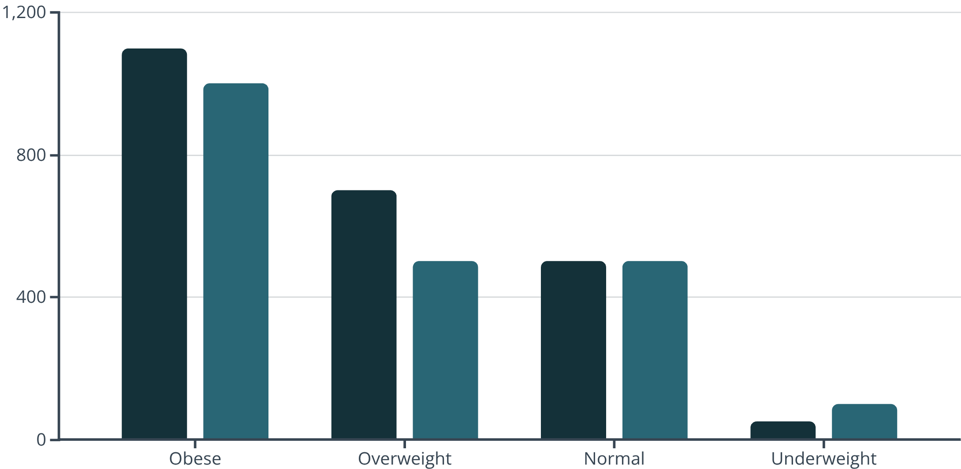
Gender Differences in BMI
Key Findings
Males consistently show higher average BMI across obese and overweight categories. The normal weight category shows equal distribution between genders, while females have twice the representation in the underweight category.
Male
Female

Slide 6
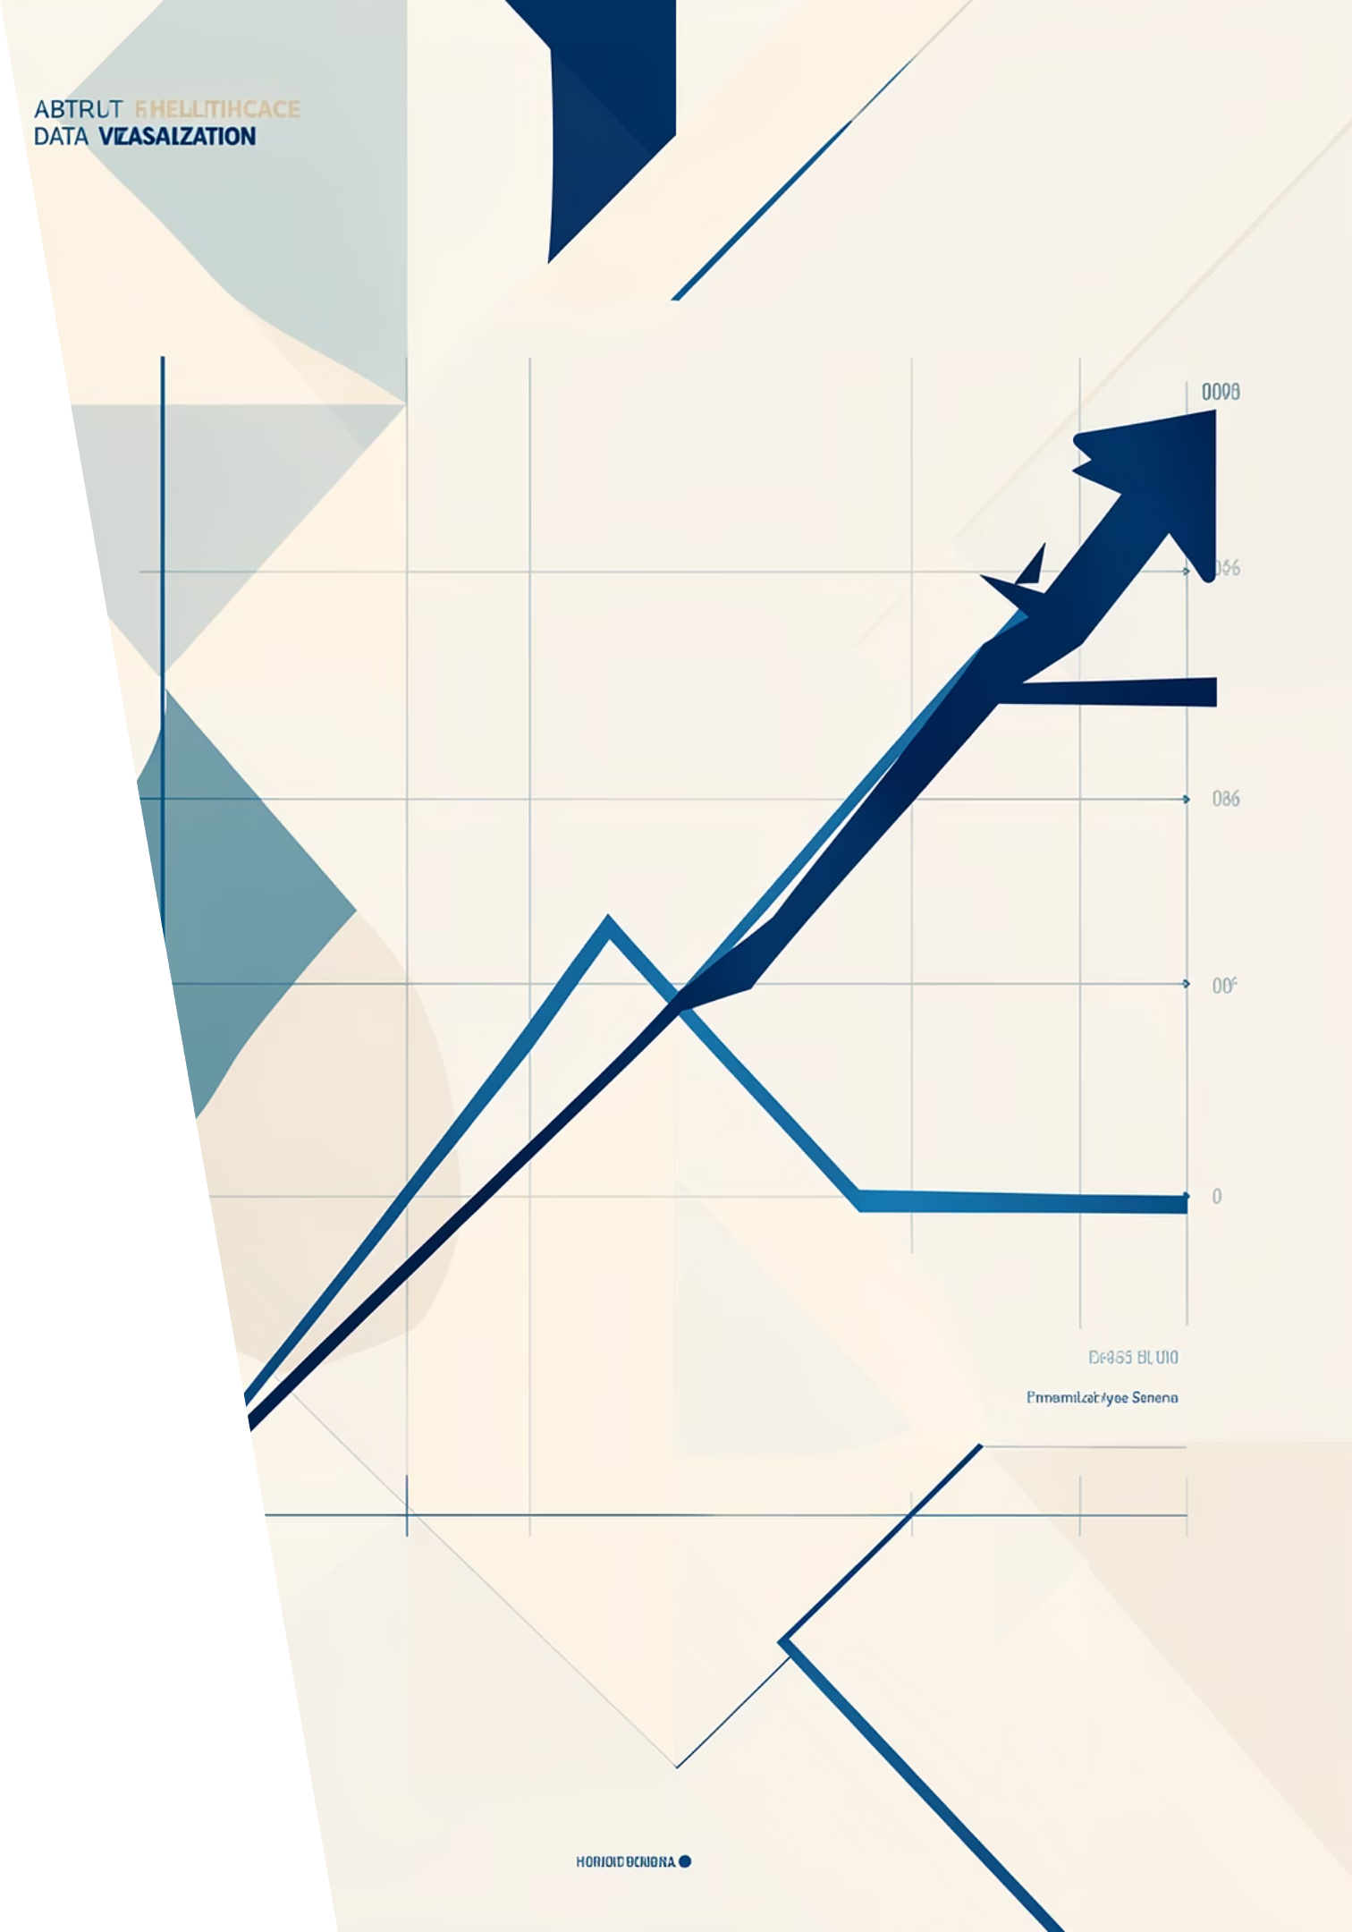
Admissions Trend by Month
Monthly hospital admissions reveal a steady decline over the 24-month period. Starting at approximately 435 admissions in month 3, the trend peaked at 438 in month 4, then showed consistent downward movement, reaching approximately 362 admissions by month 24.
This 17% decrease in admissions over two years may indicate improved preventive care, seasonal variations, or changes in healthcare delivery models.

Slide 7
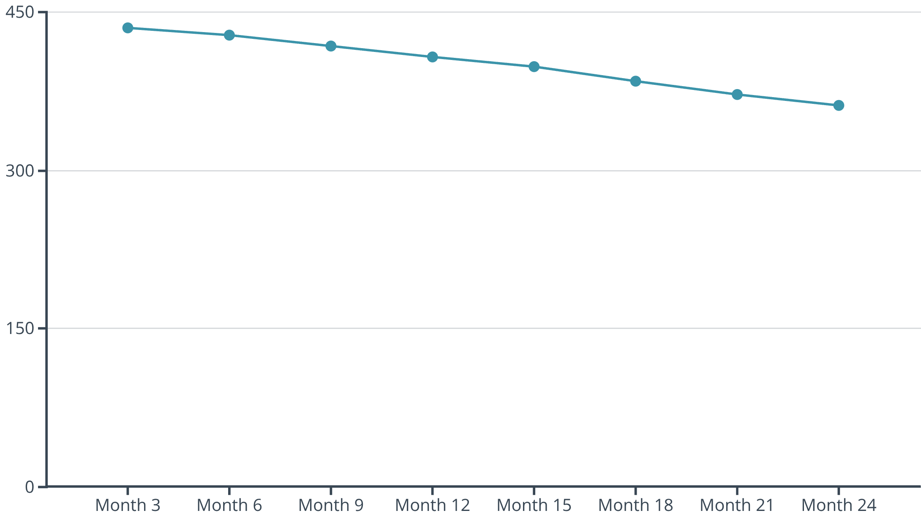
Monthly Admissions Timeline
Trend Analysis
The admissions data spans 24 months, showing clear patterns:
Peak period: Months 3-4 with 435-438 admissions
Steady decline: Consistent downward trend through month 24
Lowest point: Month 24 with 362 admissions
Overall decrease: 17% reduction over the period
This trend suggests potential improvements in outpatient care or preventive health measures reducing the need for hospital admissions.

Slide 8


Patient Distribution by Obesity Status
49.09%
50.91%
Obese Patients
Not Obese
Nearly half of all patients classified as obese
Slightly more than half maintain non-obese status
The patient population is almost evenly split between obese and non-obese classifications, with a marginal 1.82 percentage point difference. This near-equal distribution underscores the prevalence of obesity as a significant health concern requiring targeted intervention strategies.

Slide 9

BMI Score Analysis
Total BMI Score
Average BMI
Health Implications
138,000 cumulative BMI across all patients
Approximately 30.5 per patient, indicating overweight classification
Population-wide BMI suggests need for weight management programs

Slide 10


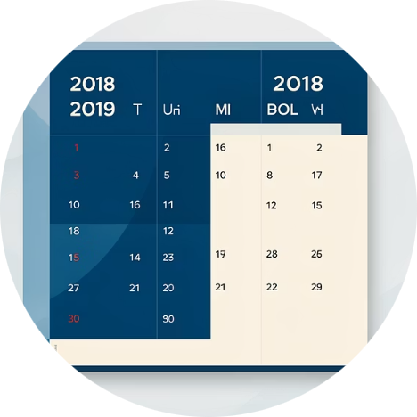

Patient Demographics Overview
Male Patients
Female Patients
Study Period
Medical Staff
Higher representation in obese and overweight categories, showing distinct gender-based health patterns
More balanced distribution across BMI categories with higher underweight representation
Data collected from June 6, 2018 to June 5, 2019, providing one full year of insights
27 doctors managing patient care across all admissions and diagnoses

Slide 11

Key Takeaways
1
2
3
Weight Management Priority
Declining Admissions
Gender-Specific Approaches
The 17% reduction in monthly admissions suggests positive trends in preventive care or outpatient treatment effectiveness
Distinct BMI patterns between males and females indicate the need for tailored health interventions by gender
With 77% of patients overweight or obese, targeted intervention programs are essential for improving population health outcomes

Slide 12
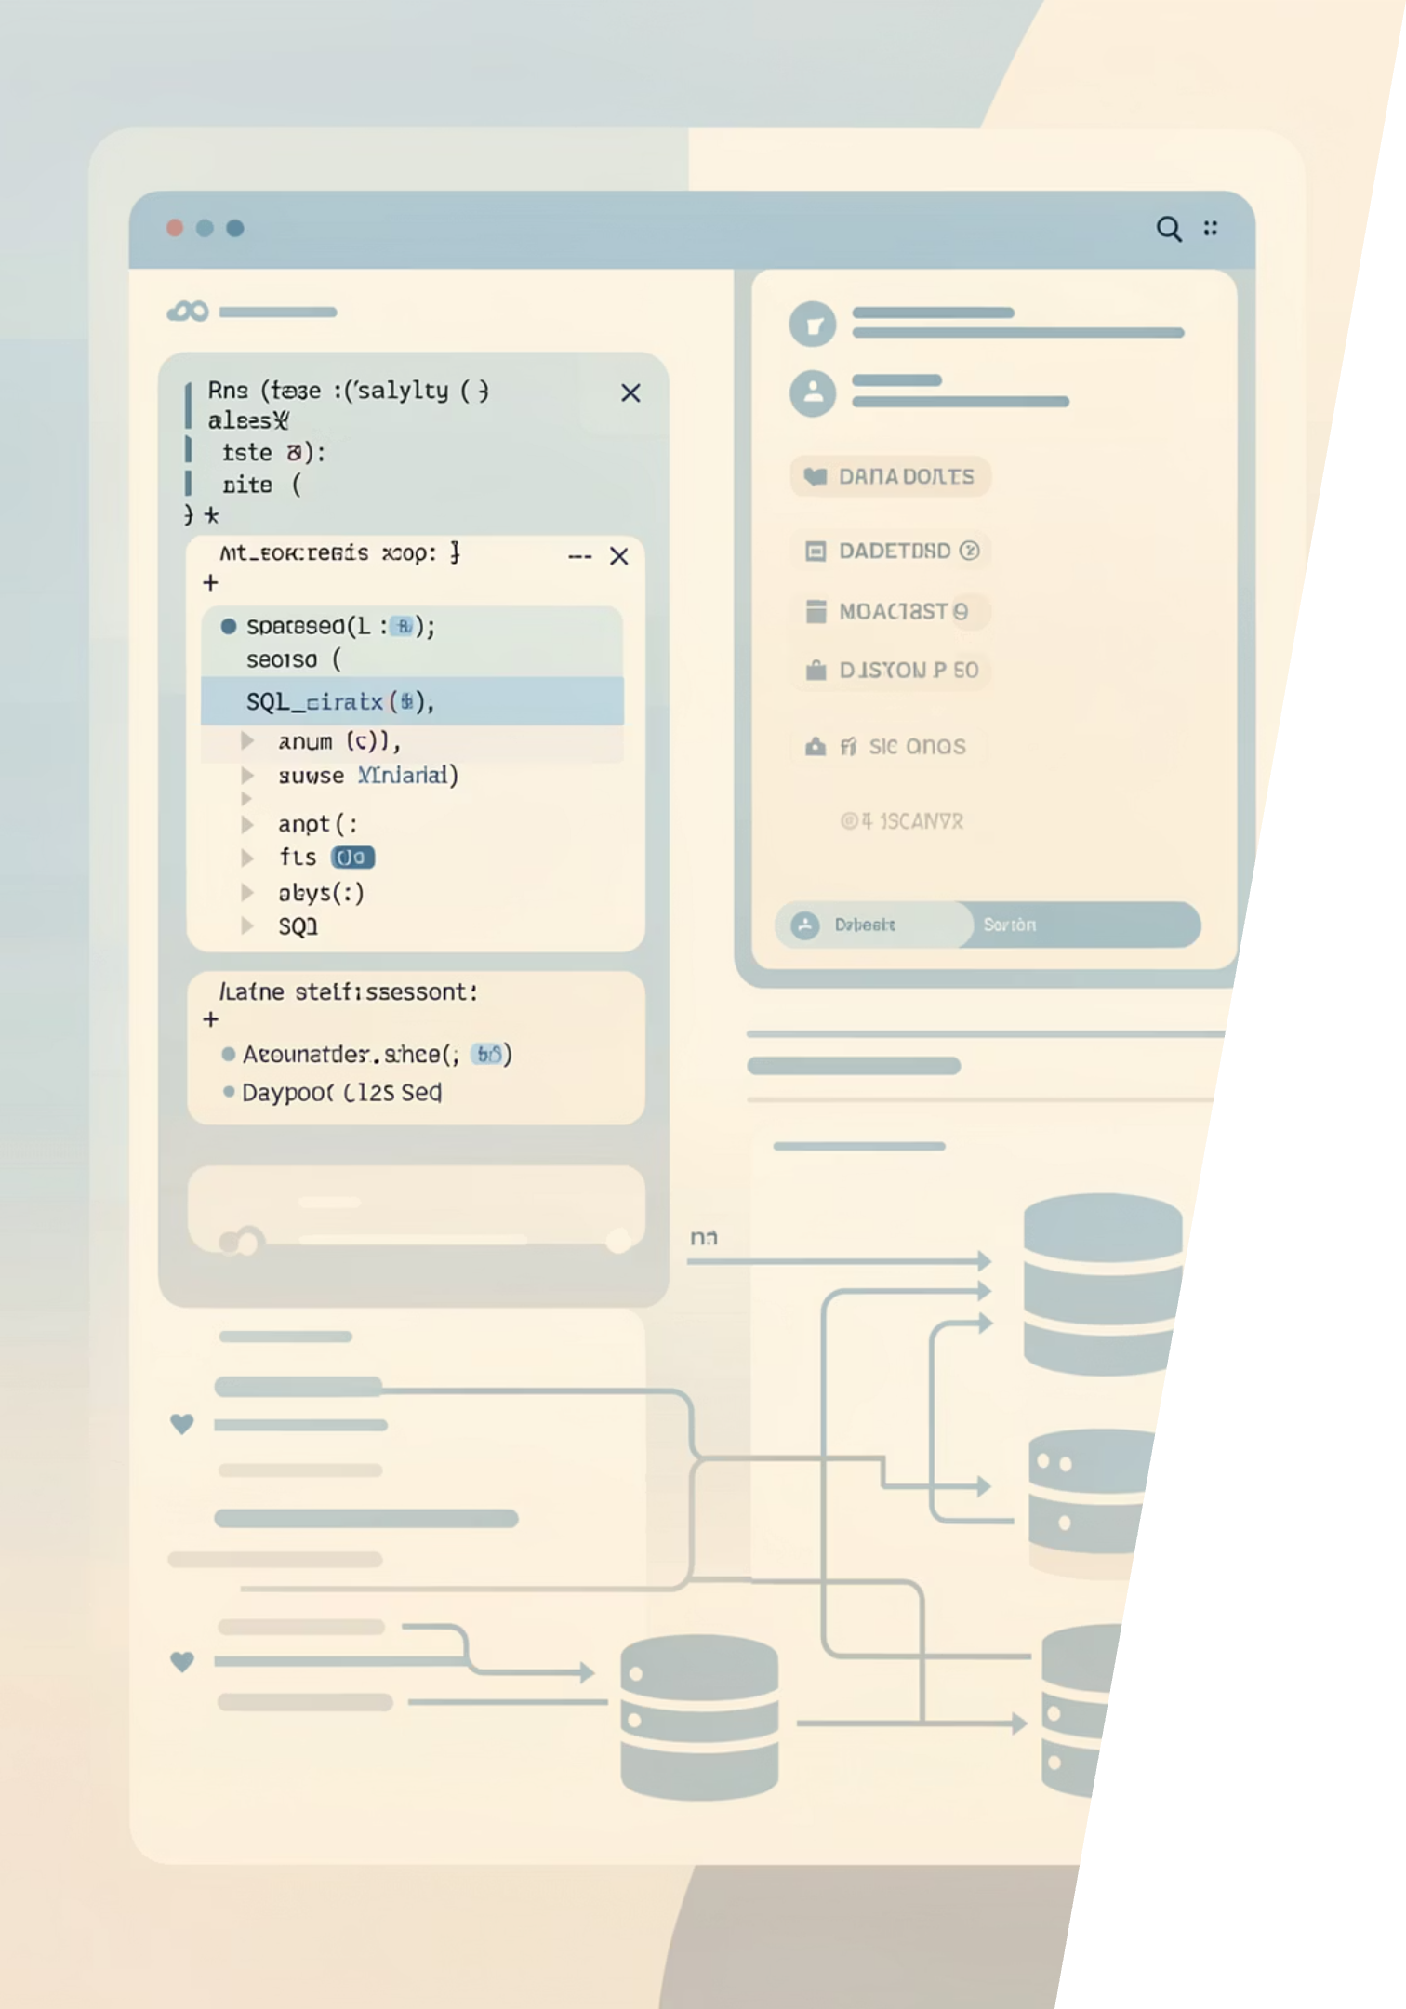
Leveraging SQL for Deeper Insights
Our analysis is powered by SQL queries, enabling precise data extraction, transformation, and loading from the medical database. This foundational approach ensures accuracy and efficiency in uncovering critical health trends.
Data Precision
Trend Identification
Custom Reporting
Extract exact information for accurate reporting.
Uncover patterns in patient data over time.
Generate tailored reports for specific metrics.

Slide 13
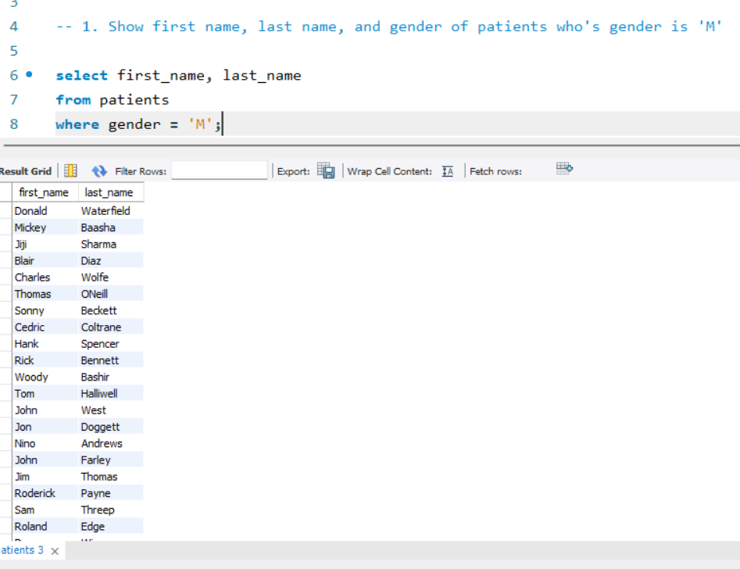

Slide 14
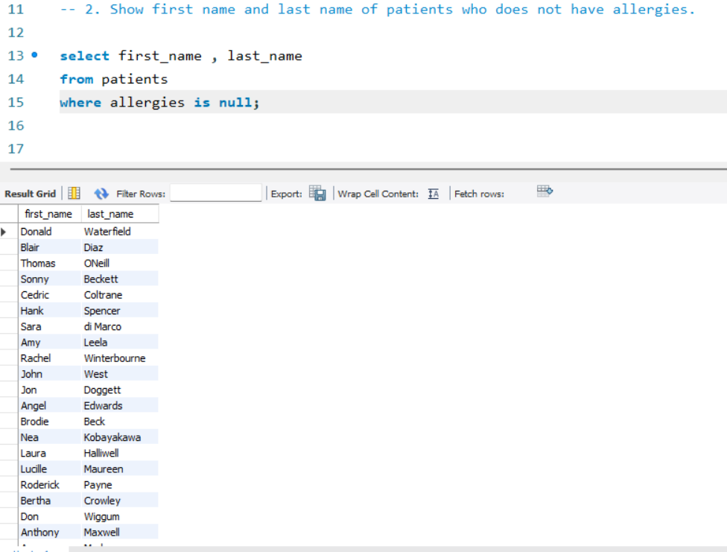

Slide 15
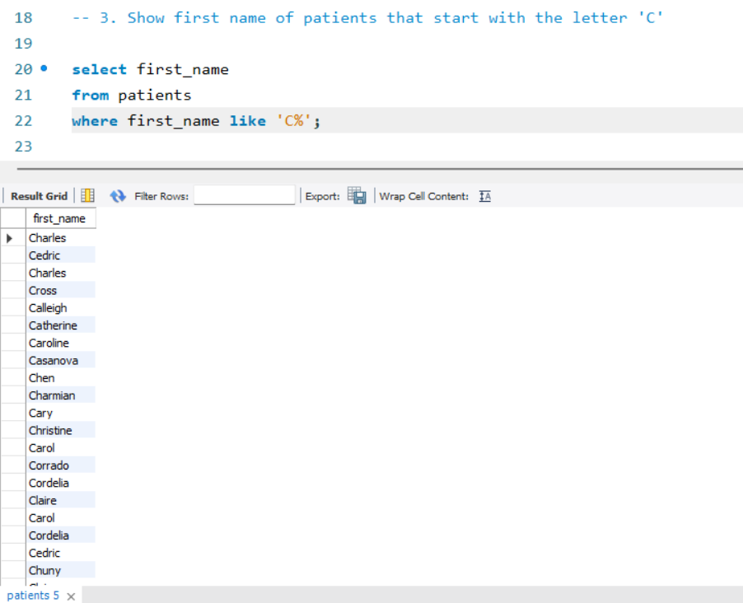

Slide 16
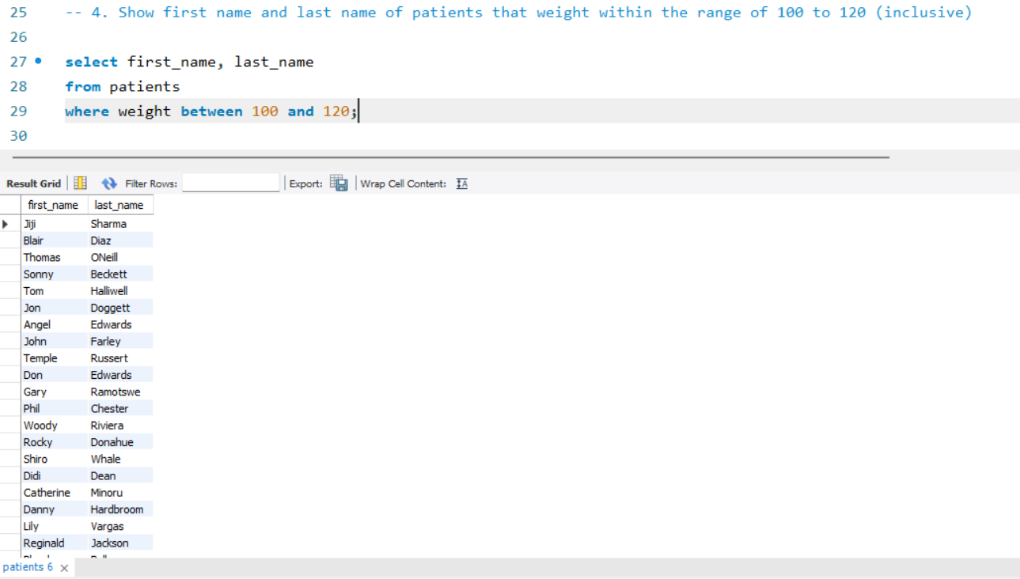

Slide 17
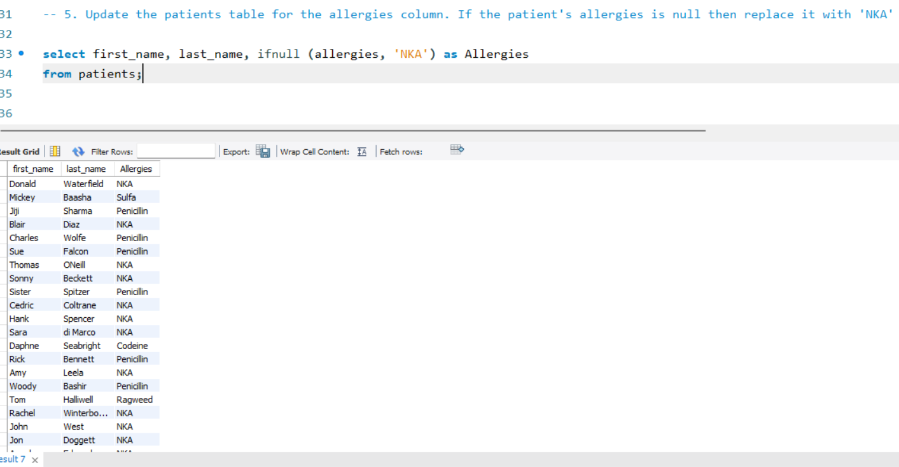

Slide 18
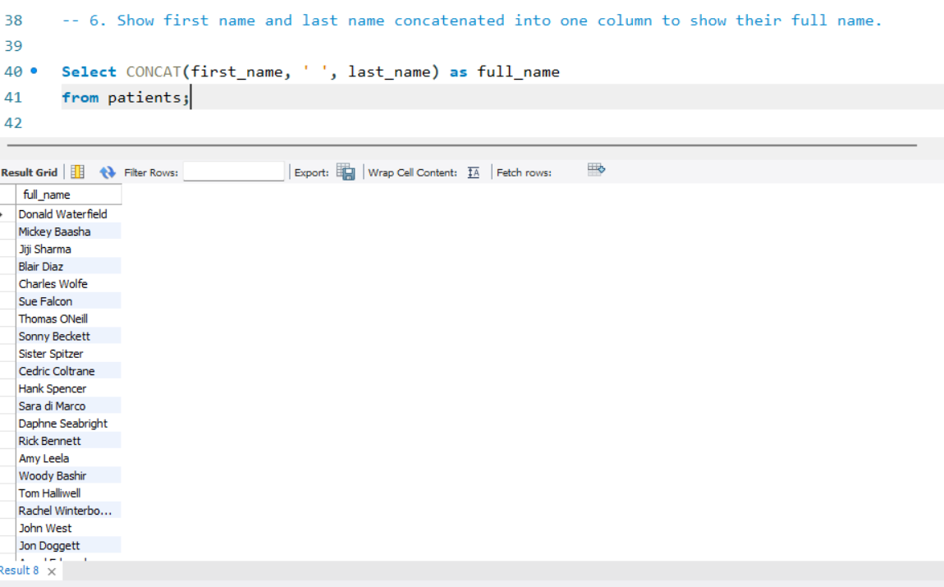

Slide 19
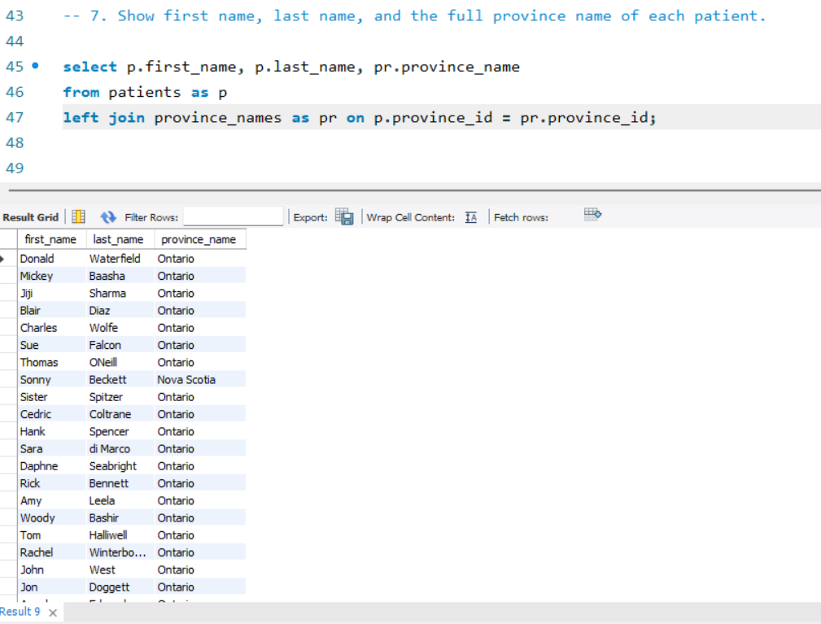

Slide 20
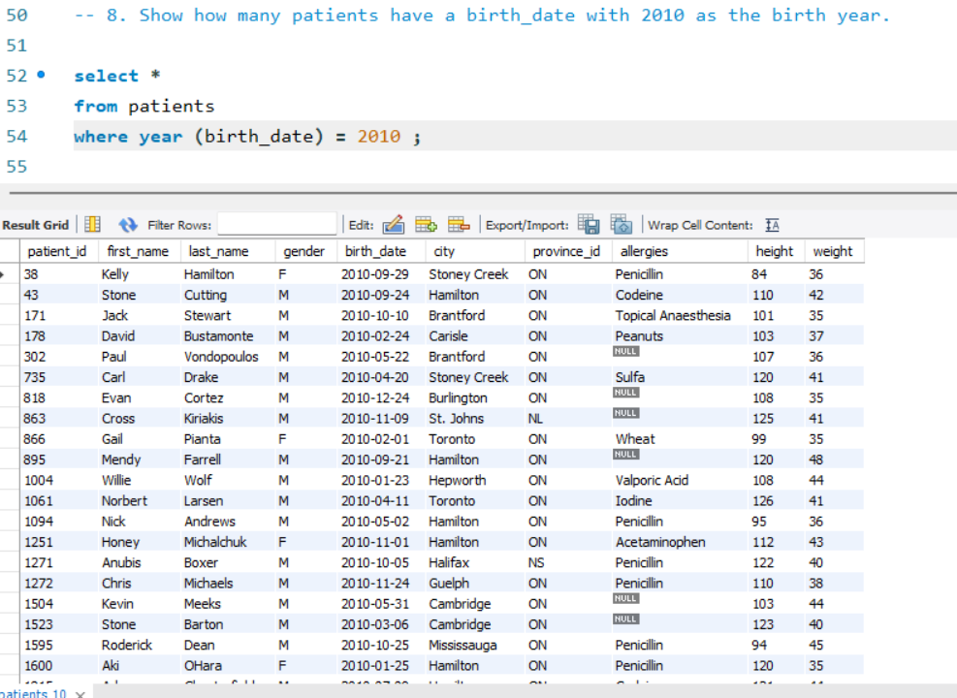

Slide 21
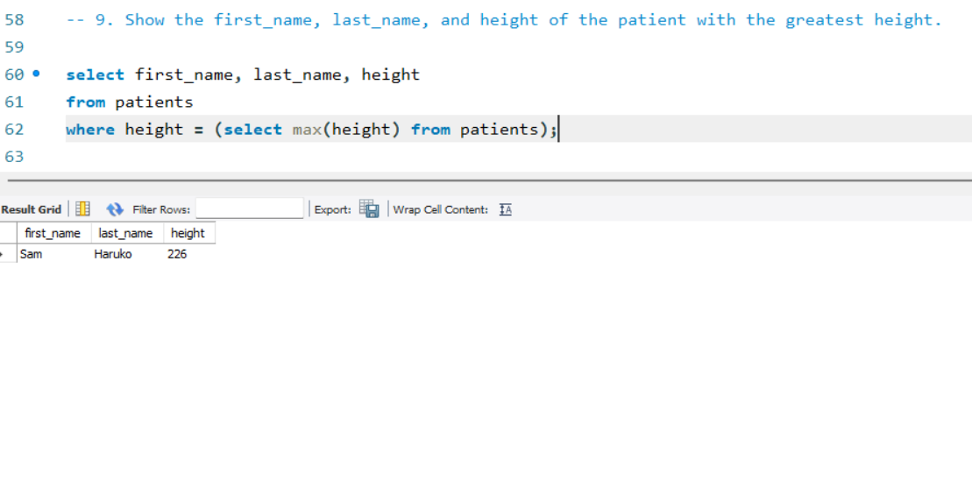

Slide 22
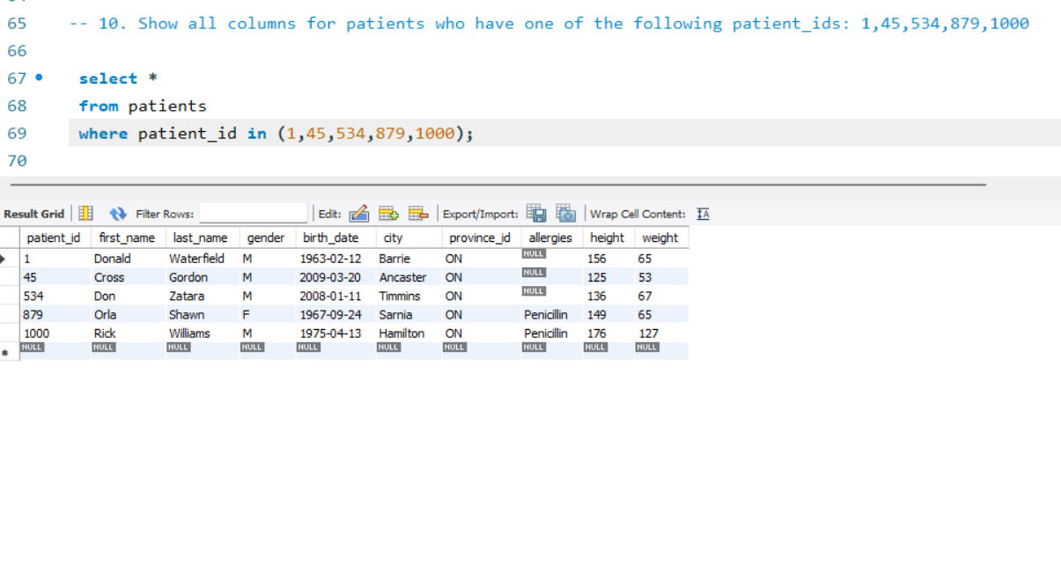

Slide 23
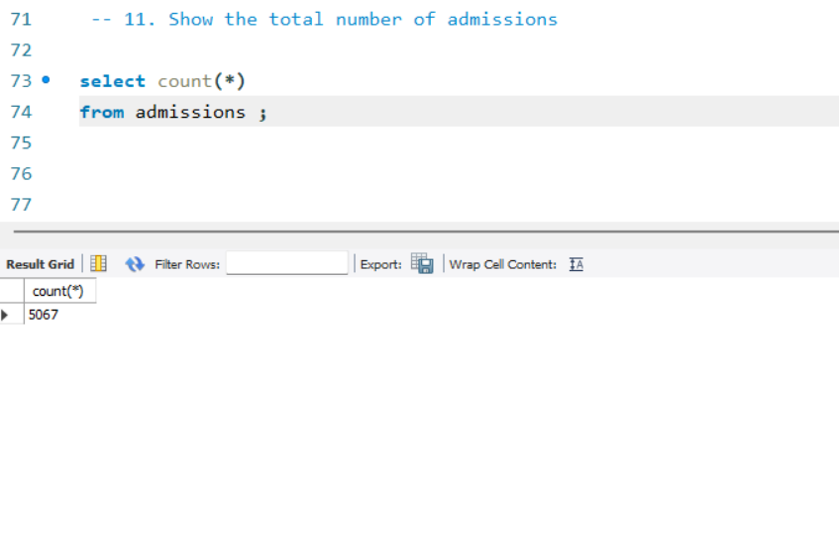

Slide 24
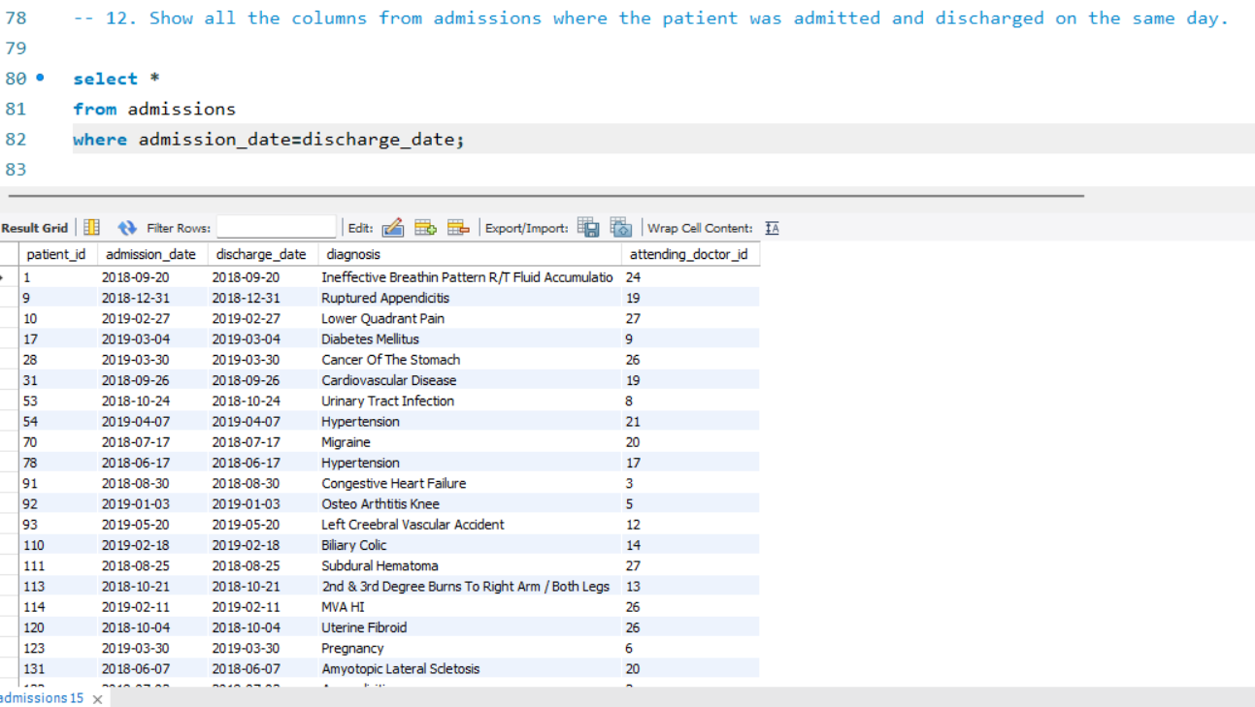

Slide 25
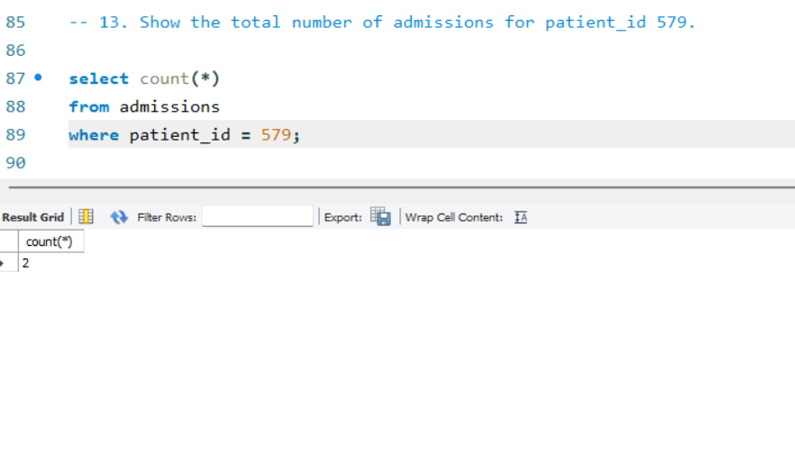

Slide 26
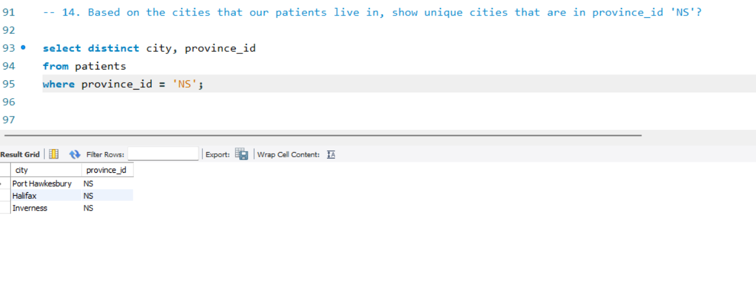

Slide 27
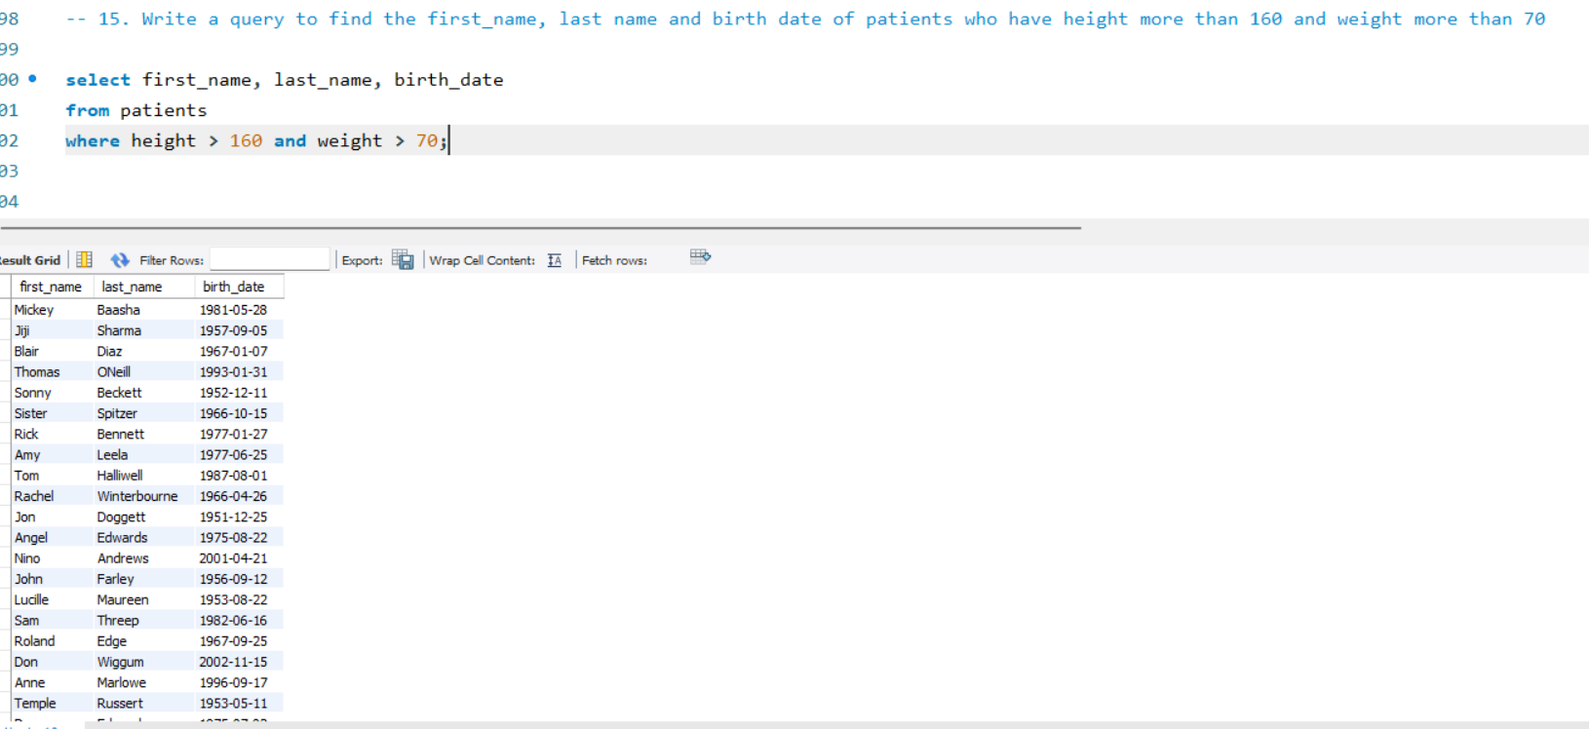

Slide 28
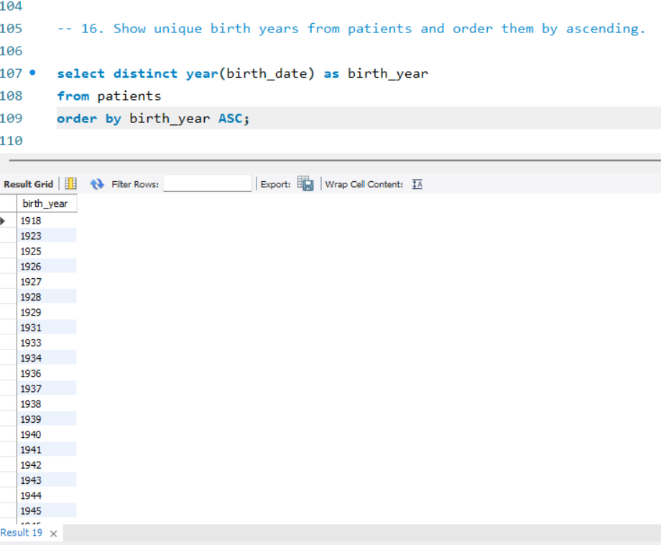

Slide 29
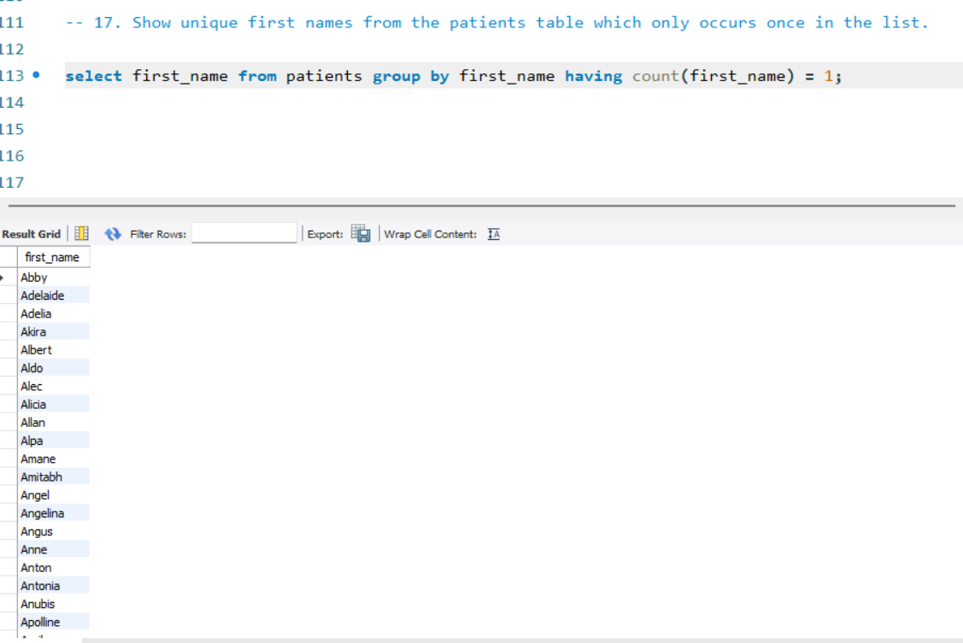

Slide 30
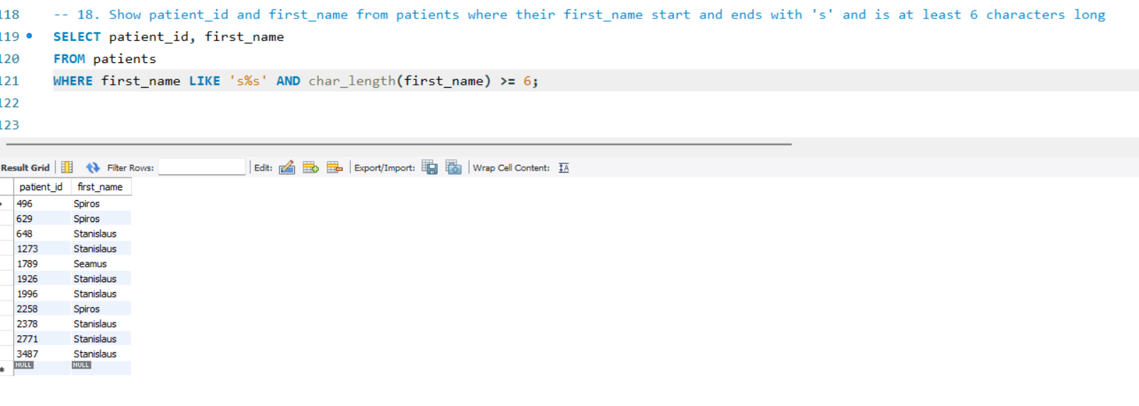

Slide 31
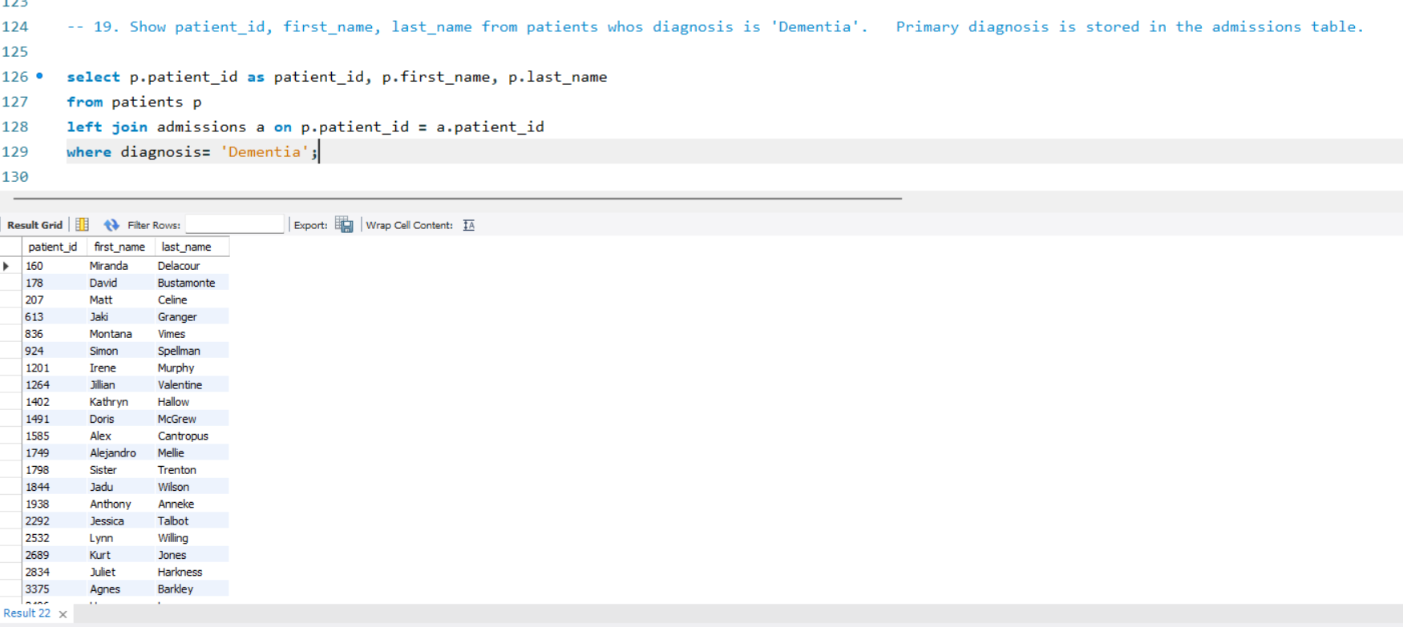

Slide 32
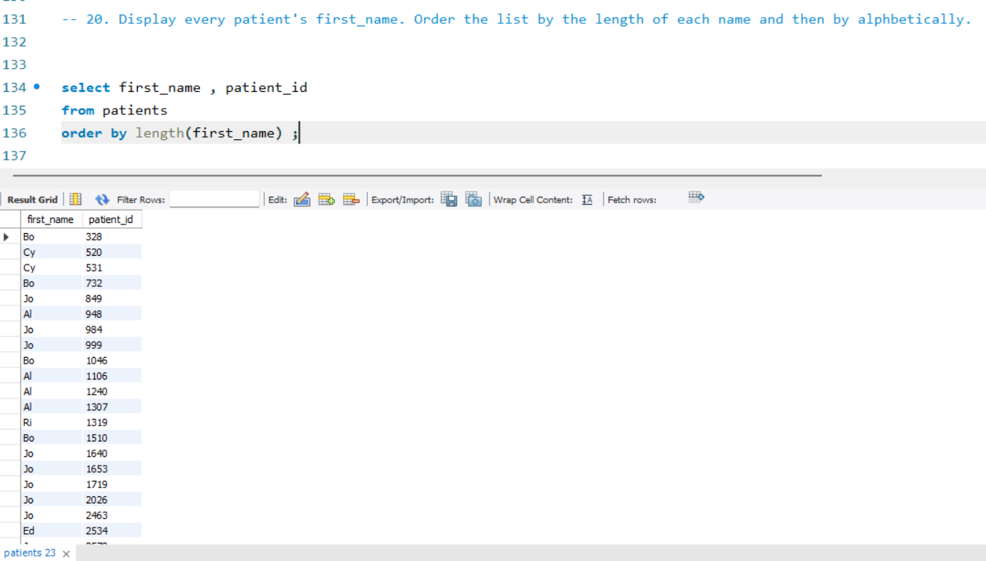

Slide 33
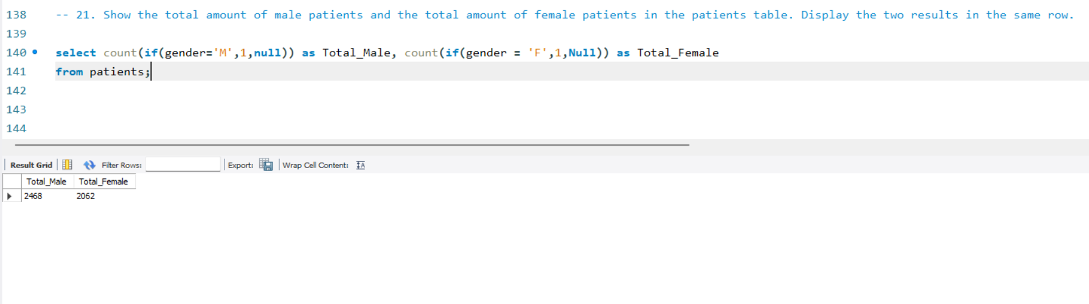

Slide 34
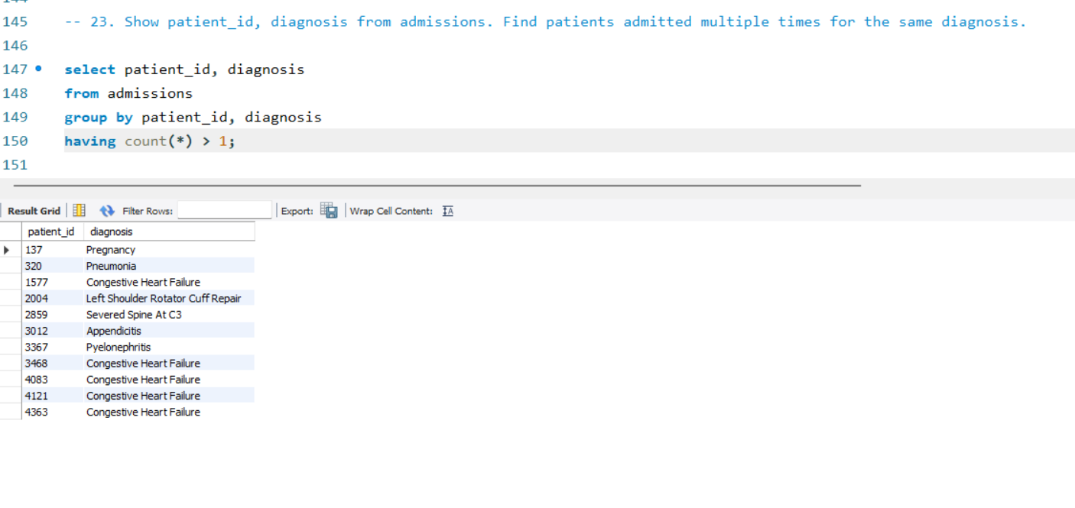

Slide 35
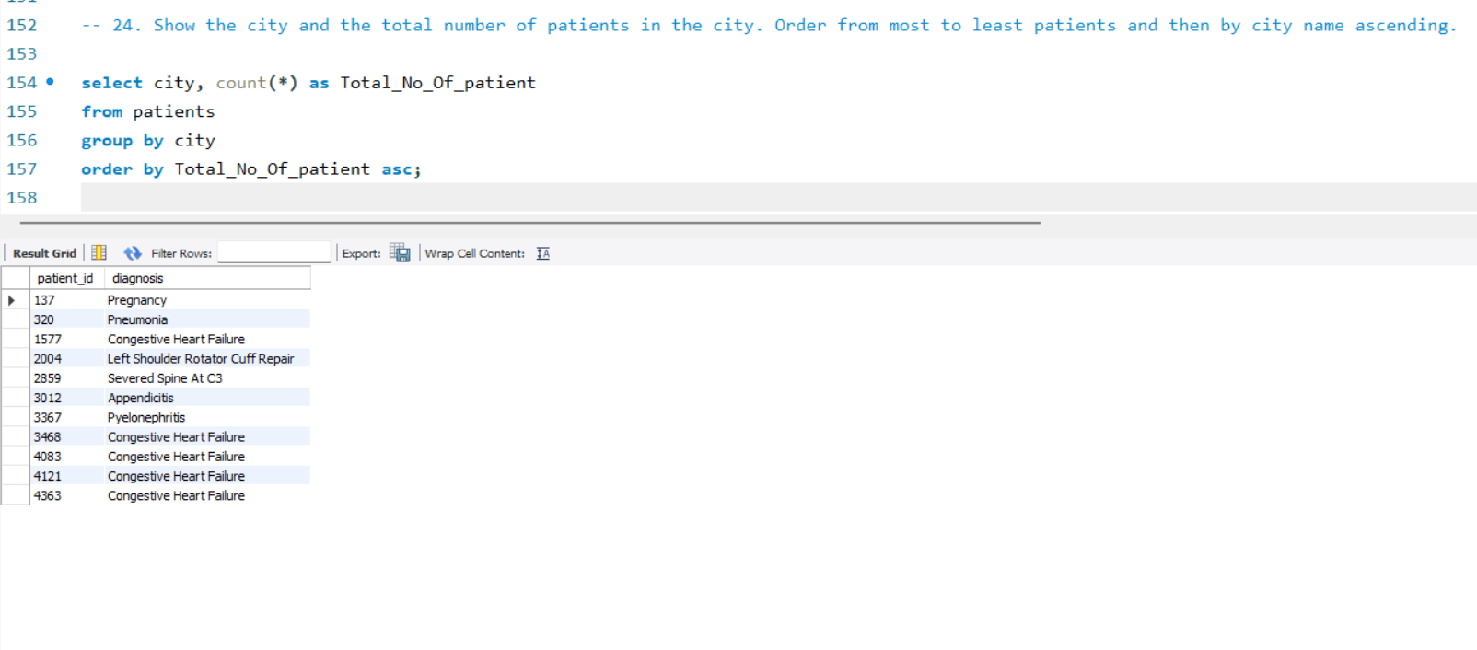

Slide 36
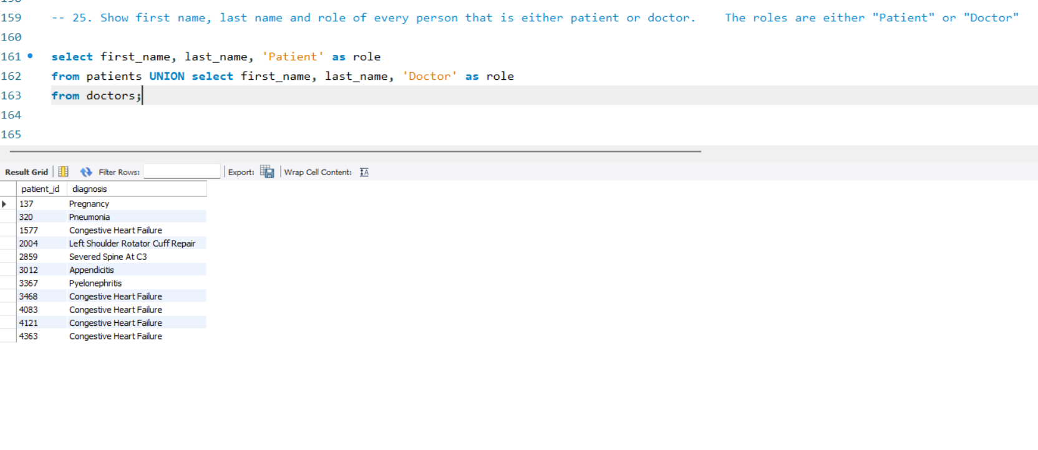

Slide 37
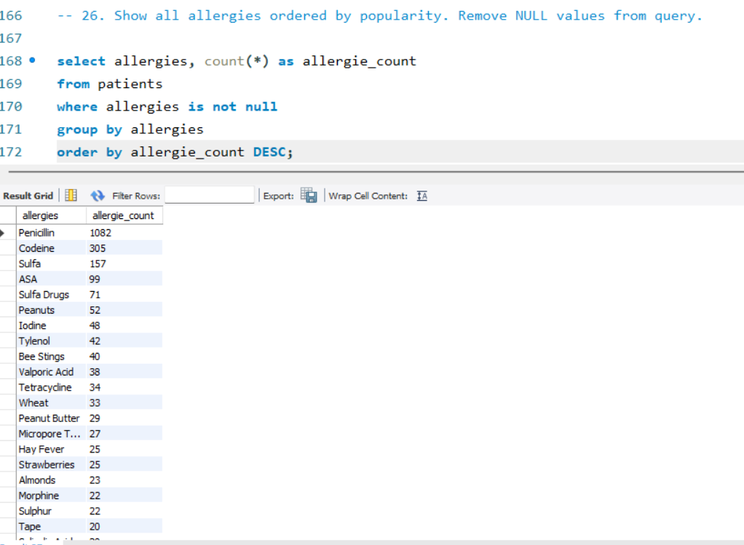

Slide 38
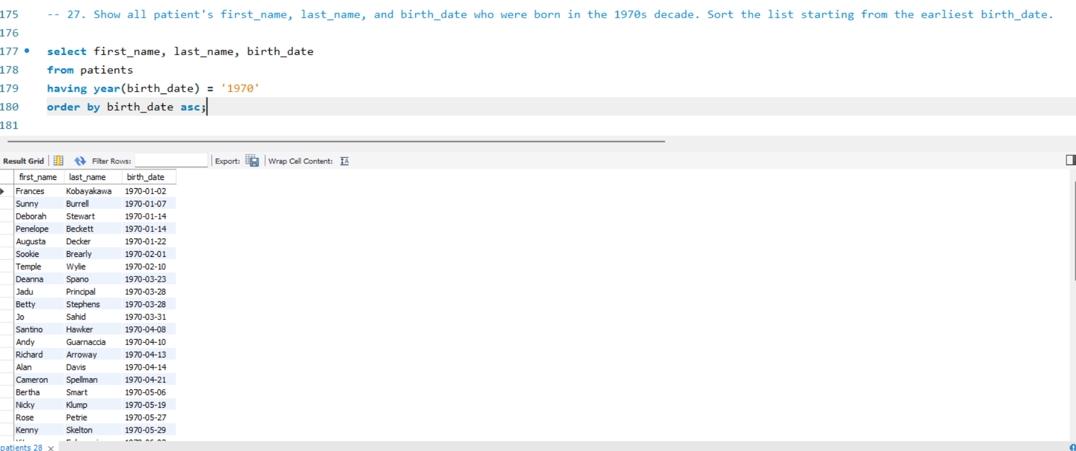

Slide 39
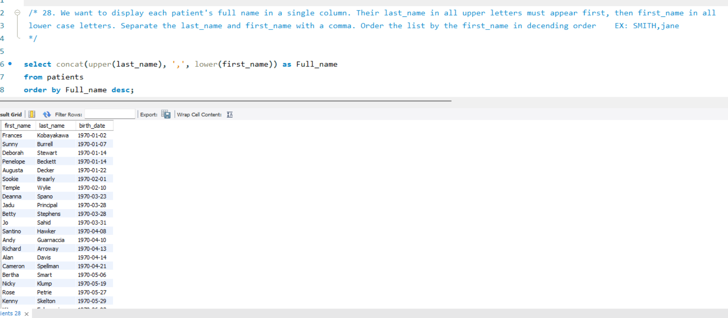

Slide 40
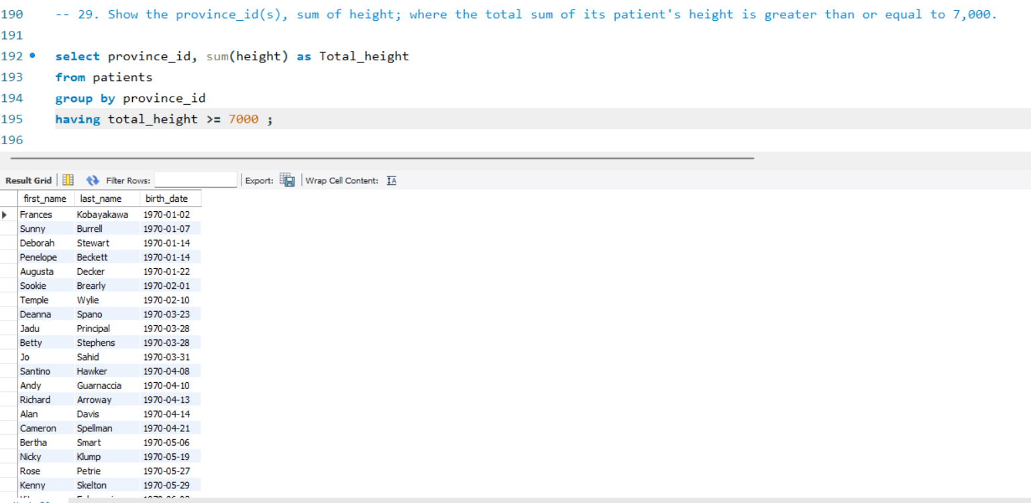

Slide 41
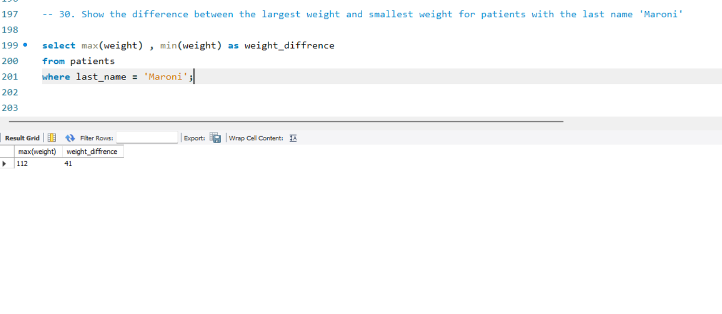

Slide 42
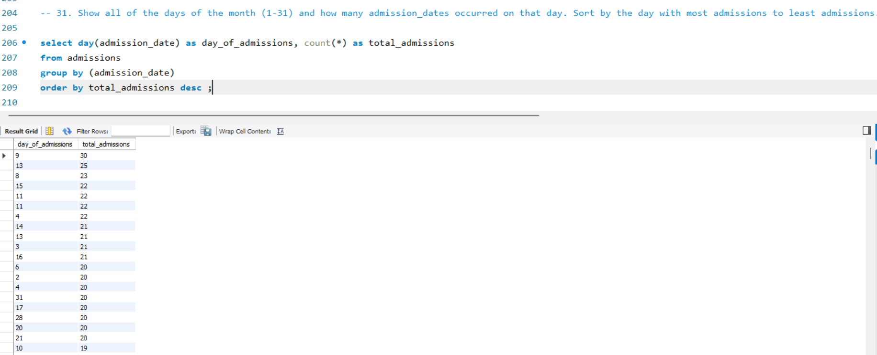

Slide 43
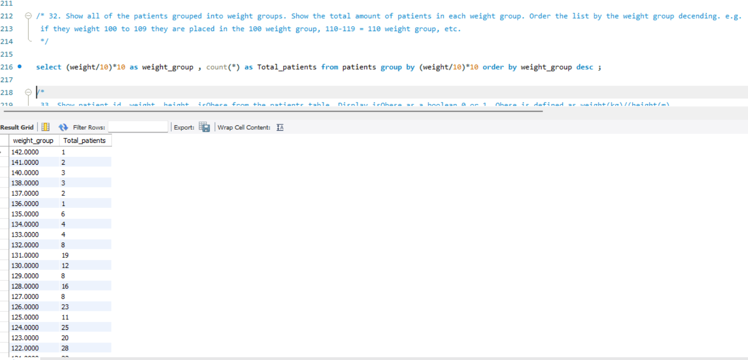

Slide 44
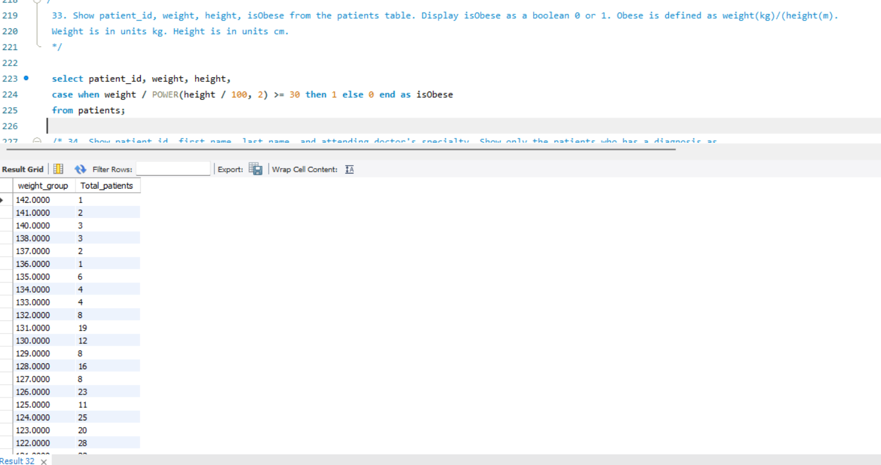

Slide 45
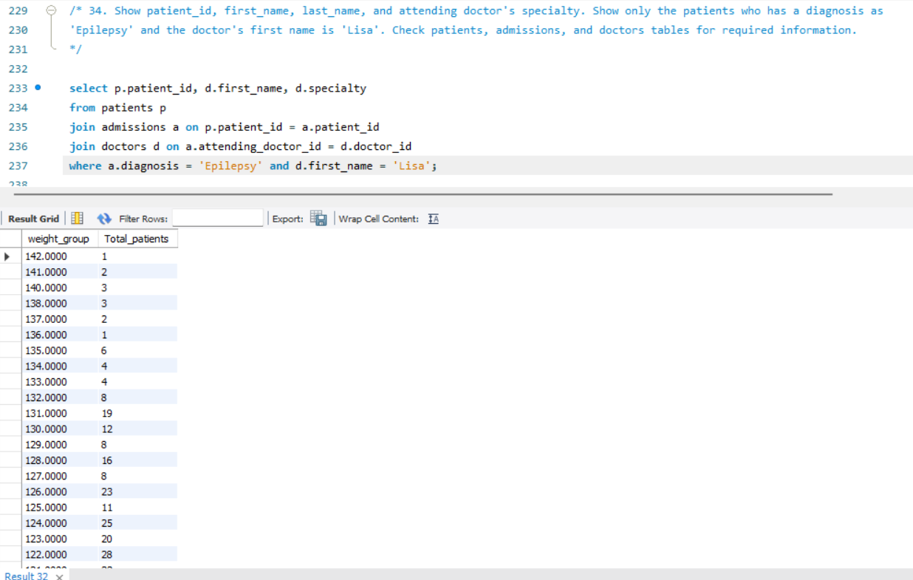

Slide 46
Thank You For Your Time And Consideration
Name: Dhanraj Beldar
Role: Data Analyst
Tools : SQL | Power BI | Excel
LinkedIn: www.linkedin.com/in/dhanraj-beldar-ab8a0232a

